Slide 1
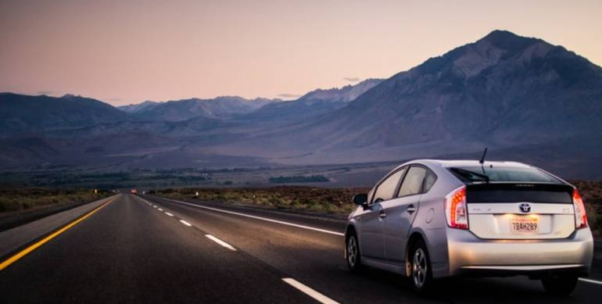
ROAD TRAFFIC SIGNS RECOGNITION
- A Final Project by Team 132, Batch 8, 2020
Syed Mohammed Quadri
Nabil Mohammed Asif

Slide 2
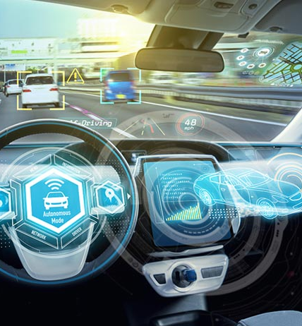
Our Topics
Road Traffic Sign Recognition
Convolutional Neural Networks
1
2
Demo
Building The Project
3
4
Summary
5

Slide 3
Road Traffic Sign Recognition
Traffic sign recognition is the process of automatically identifying which of the following class the sign belongs to.
Purpose
Advantages
Applications
To improve the driver's safety on the road.
Informs the condition of roads.
Helps regulate traffic.
Reduces accidents.
Fully automated driving
Driver assistance systems

Slide 4
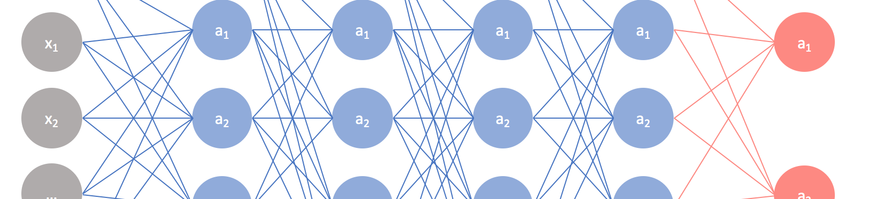
Convolutional Neural Networks
A convolutional neural network (CNN) is a type of artificial neural network used in image recognition and processing that is specifically designed to process pixel data.
Use of CNN
Image Representation
Edge Detection
Layers in CNN

Slide 5
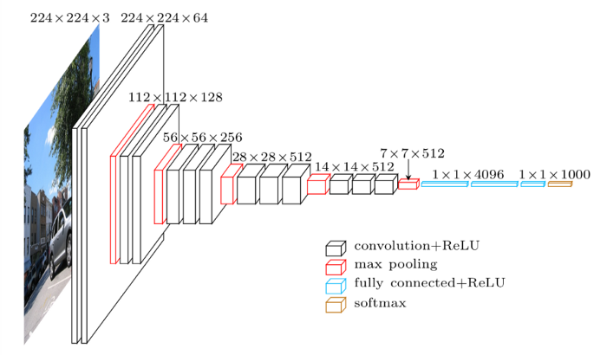
Use of CNN
In simple word what CNN does is, it extract the feature of image and convert it into lower dimension without loosing its characteristics.

Slide 6
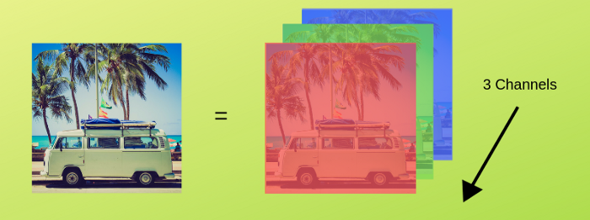
Image Representation
Images are encoded into color channels, the image data is represented into each color intensity in a color channel at a given point, the most common one being RGB, which means Red, Blue and Green.

Slide 7
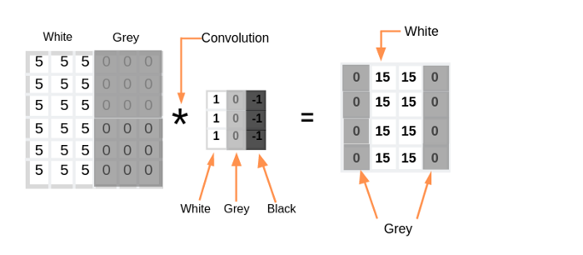
Edge Detection
Every image has vertical and horizontal edges which actually combining to form a image. Convolution operation is used with some filters for detecting edges.

Slide 8
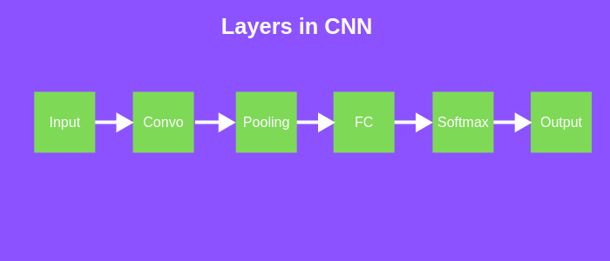
Layers in CNN
There are six different layers in CNN
Input
layer
Convo
layer
Pooling
layer
Fully
Connected
layer
Softmax
/logistic
layer
Output
Layer

Slide 9
Input Layer
Input layer in CNN should contain image data. Image data is represented by three dimensional matrix as we saw earlier.
Convo Layer
Convo layer is sometimes called feature extractor layer because features of the image are get extracted within this layer.
Pooling Layer
Pooling layer is used to reduce the spatial volume of input image after convolution.

Slide 10
Fully Connected Layer
Fully connected layer involves weights, biases, and neurons. It connects neurons in one layer to neurons in another layer.
SoftMax / logistic Layer
Convo layer is sometimes called feature extractor layer because features of the image are get extracted within this layer.
Output Layer
Output layer contains the label which is in the form of one-hot encoded.

Slide 11
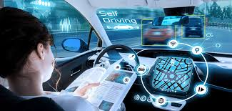
Demo

Slide 12
Building The Project
The steps to build our project.
The Setup
Importing
Creating the data
Open up the terminal to access the project folder. To start the jupyter notebook you have to type “Jupyter notebook” in the terminal and it will open up in a browser.
First import the os module, numpy, pandas, matplotlib, pil, keras and we will explain the role of each function when we use them.
An image is made up of pixels and each pixel has 3 values to specify its color. we use the PIL library that can perform many image manipulation tasks.

Slide 13
Building The Project
The steps to build our project.
Making data ready
The Model
Training
We are going to use the sklearn train_test_split() function that will randomly split the data into training and validation set. One hot encoding is a vector representation where all elements of the vector are 0 except one, which has 1 value.
A Convolutional Neural Network(CNN) is made up of convolutional and pooling layers. We have also used the dropout layer which is used to handle the overfitting of the model.
We use the model.fit() function which takes the training set, validation set, batch size and no of epochs.

Slide 14
Building The Project
The steps to build our project.
Training
Plotting graph
Testing
We use the model.fit() function which takes the training set, validation set, batch size and no of epochs.
With the help of matplotlib functions, we will plot the graph of training and validation accuracy
We have a test folder that contains around 12,000 images. The test.csv file contains the path of the image along with the label of the class.

Slide 15
Building The Project
The steps to build our project.
Building the GUI
A graphical user interface will save a lot of time in testing and seeing the results of our model prediction. We used Tkinter, which is an inbuilt library of python to make the GUI.

Slide 16


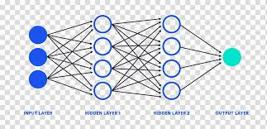
Summary
Hope you enjoyed and learned a lot with our project.
Computer vision
Deep Learning techniques
Convolutional neural network

Slide 17
Thank You

